Slide 1
Advanced Time Series Predictions WS26
Project Title:
AI-Driven Options Portfolio Optimization System
Presented By Sajjad Haider
Date:02.02.2026

Slide 2
Agenda
1. Project Overview & Objectives
2. Data Analysis & Feature Engineering
3. Machine Learning Model Development
4. Model Performance Comparison
5. Portfolio Construction & Optimization
6. Risk Analysis & Management
7. Trading Strategy Recommendations
9. Key Technological Innovation
8. Conclusion & Next Steps

Slide 3
1. Project Overview & Objectives
📊 Core Concept: This project develops an advanced AI-powered system that predicts option prices and identifies optimal trading opportunities across multiple asset classes (Gold, DAX, EUR/USD) using machine learning and ensemble methods.
⚡ Innovation: Traditional options pricing models like Black-Scholes rely on theoretical assumptions. Our system uses market data and advanced feature engineering to create more accurate, data driven predictions that adapt to current market conditions.
🎯 Outcome: The system identifies mispriced options, recommends optimal portfolio allocations and provides risk adjusted trading strategies - giving traders a competitive edge in derivatives markets.

Slide 4
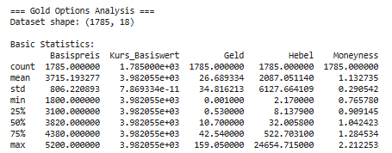
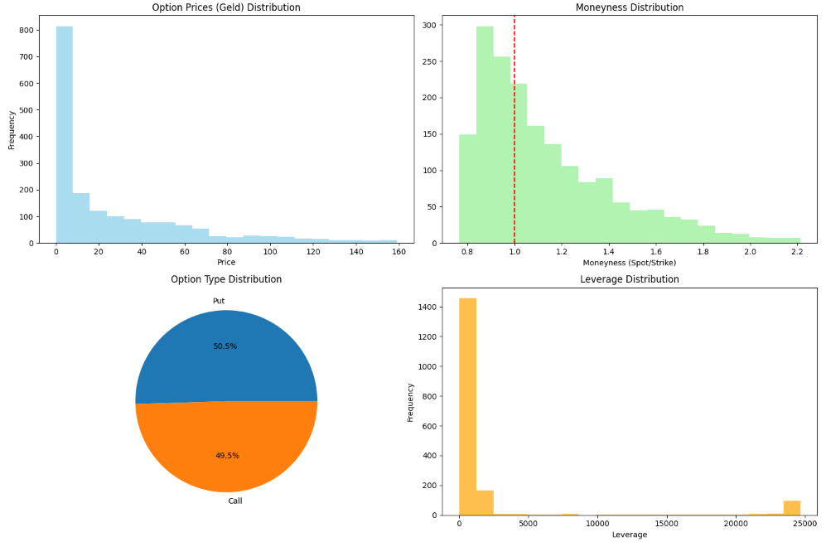
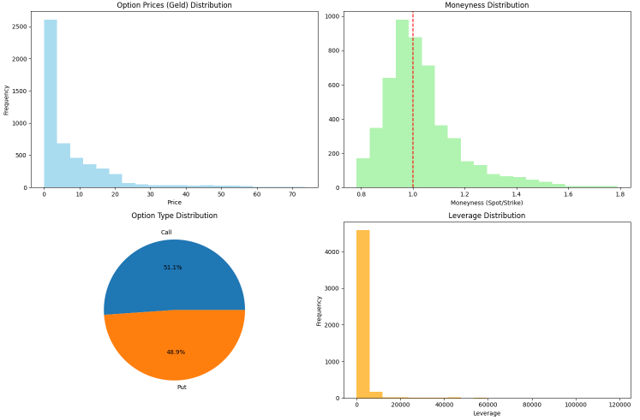
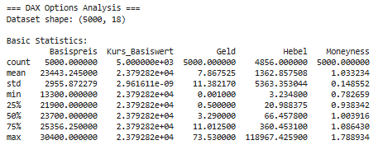
2. Data Analysis & Feature Engineering - Gold & DAX

Slide 5
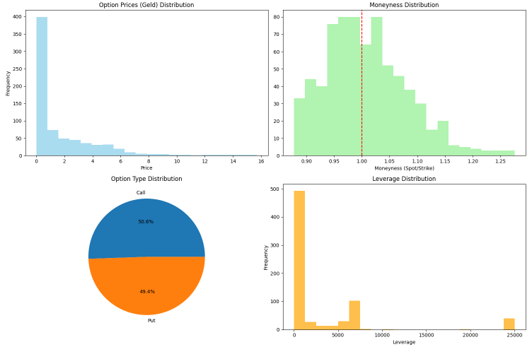
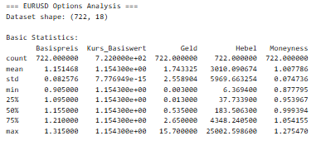
2. Data Analysis & Feature Engineering - EURUSD

Slide 6
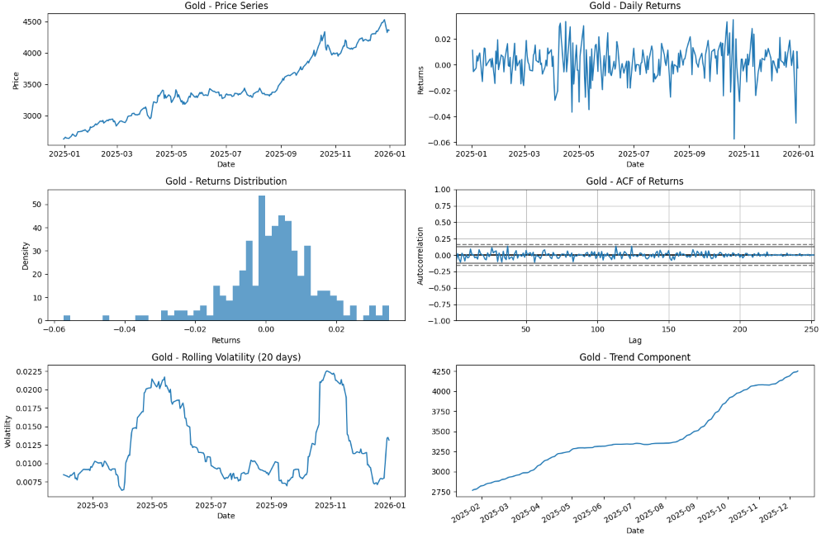
2.1 Time Series Analysis - GOLD

Slide 7
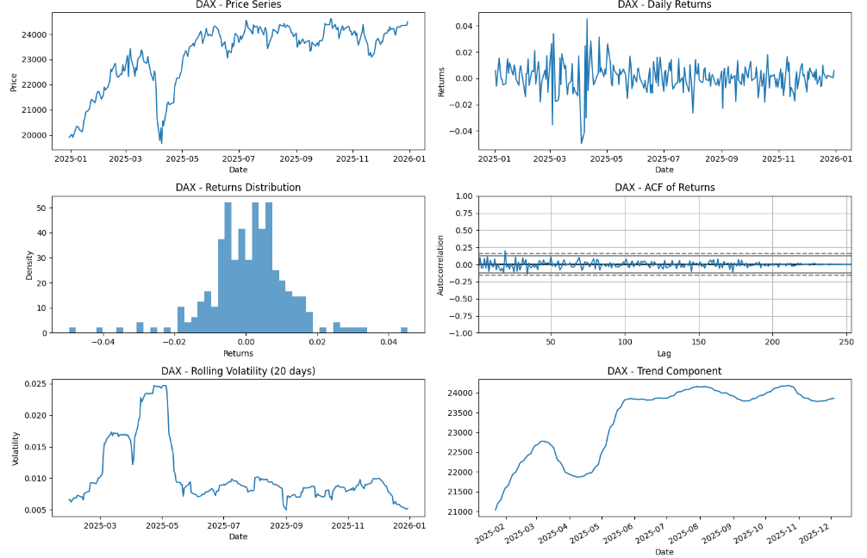
2.1 Time Series Analysis - DAX

Slide 8
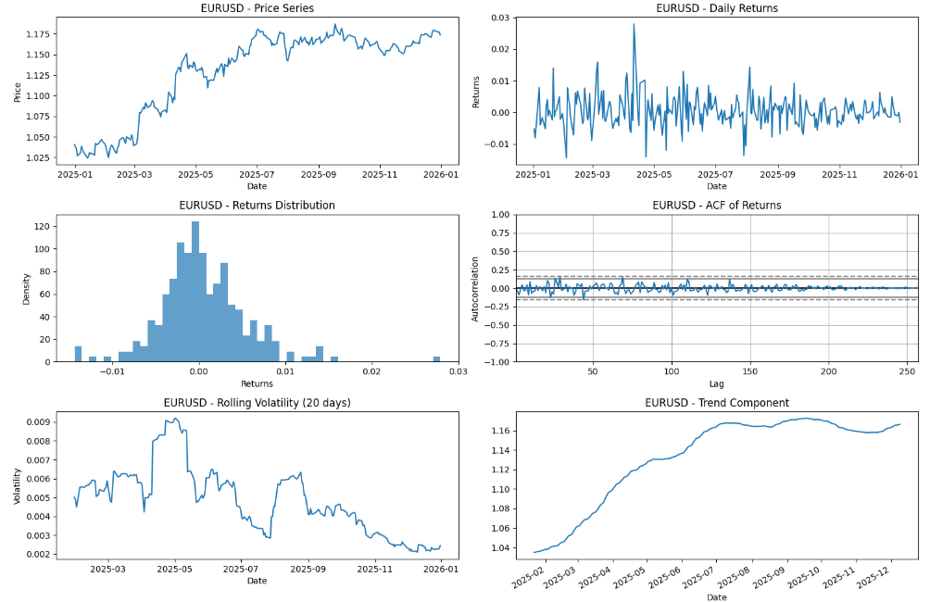
2.1 Time Series Analysis - EURUSD

Slide 9
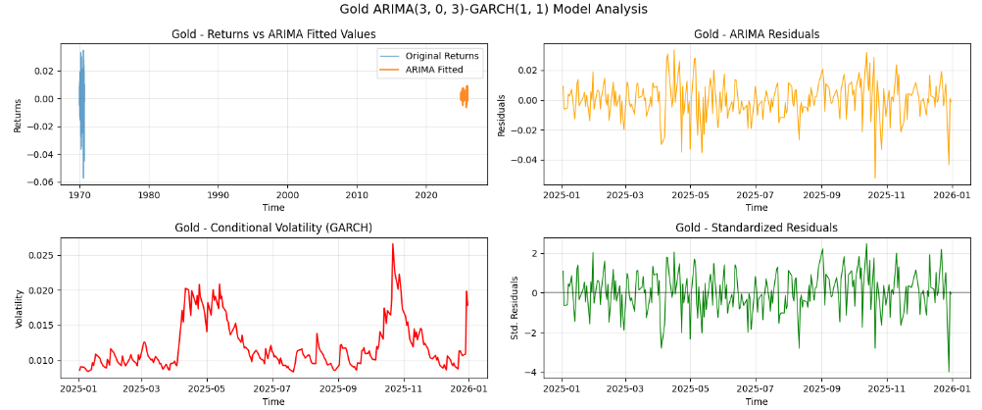
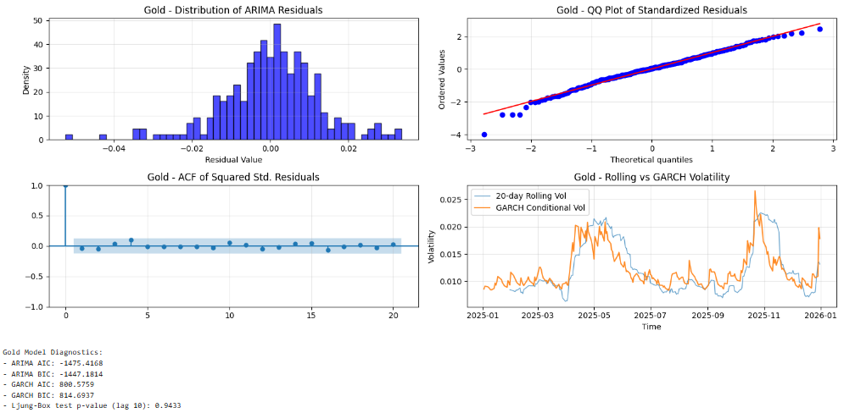
2.2 ARIMA GARCH Modelling - GOLD

Slide 10
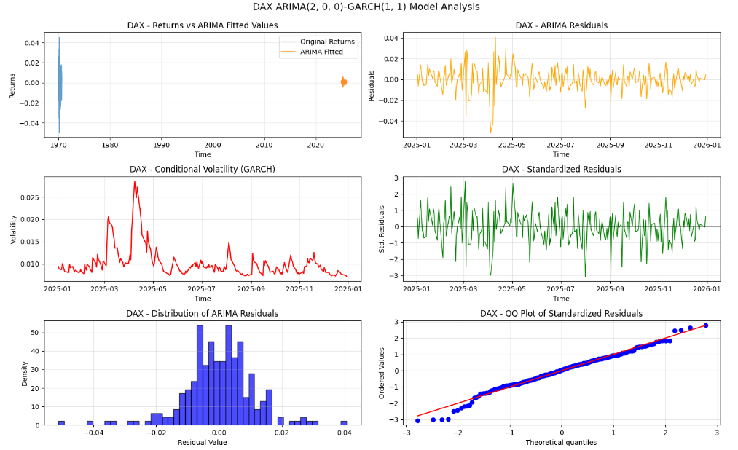
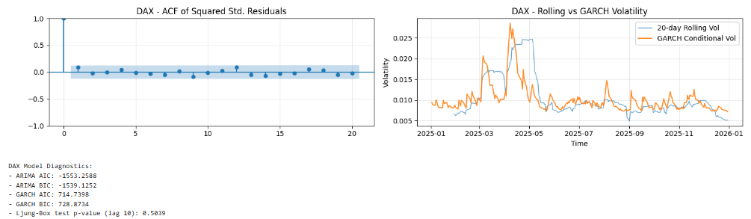
2.2 ARIMA GARCH Modelling - DAX

Slide 11
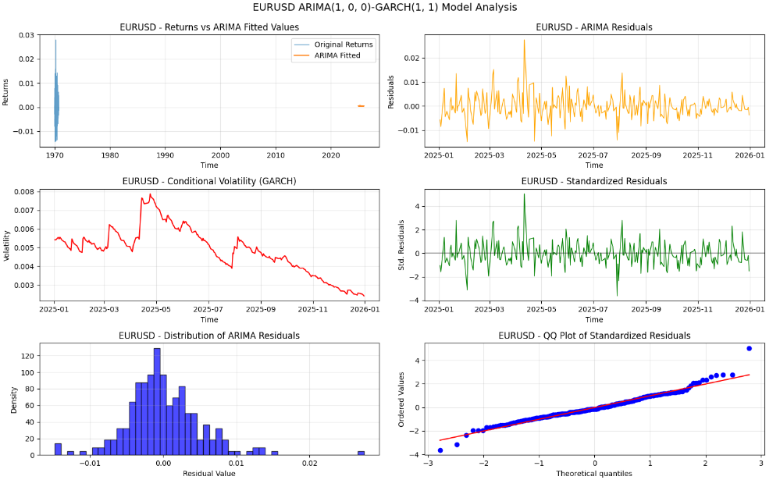
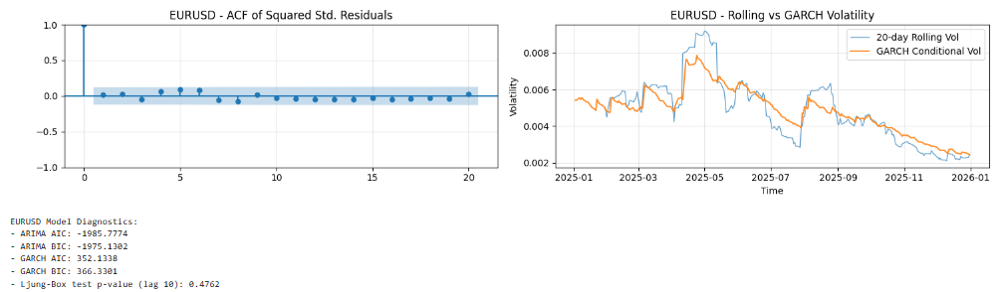
2.2 ARIMA GARCH Modelling - EURUSD

Slide 12
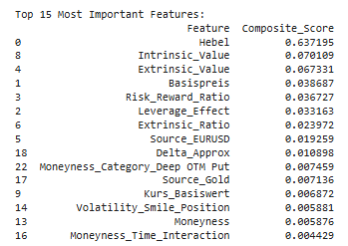
2.3 Advanced Feature Engineering
Purpose: Transforms raw options data into powerful predictive features that capture market dynamics.
Key Features Created:
Time-based Features: Expiration timelines, seasonal patterns
Option Greeks Approximation: Delta, Gamma estimates using Black-Scholes principles
Moneyness Metrics: How far in/out of the money each option is
Volatility Features: Implied volatility characteristics and smile positioning
Risk-Return Metrics: Leverage effects, risk-adjusted return potential
Market Microstructure: Bid-ask spreads, liquidity measures
Innovation: Goes beyond basic options data to create sophisticated features that capture complex market relationships.

Slide 13
3. Machine Learning Model Development
Purpose: Implements three powerful machine learning algorithms to predict option prices.
Models Used:
XGBoost: Extreme Gradient Boosting - handles complex non-linear relationships
LightGBM: Light Gradient Boosting - optimized for speed and efficiency
Random Forest: Ensemble of decision trees - robust against overfitting
Advanced Techniques:
Hyperparameter optimization using Optuna for peak performance
Cross-validation ensures model robustness
Ensemble methods combine strengths of all three models
SHAP analysis provides model interpretability

Slide 14
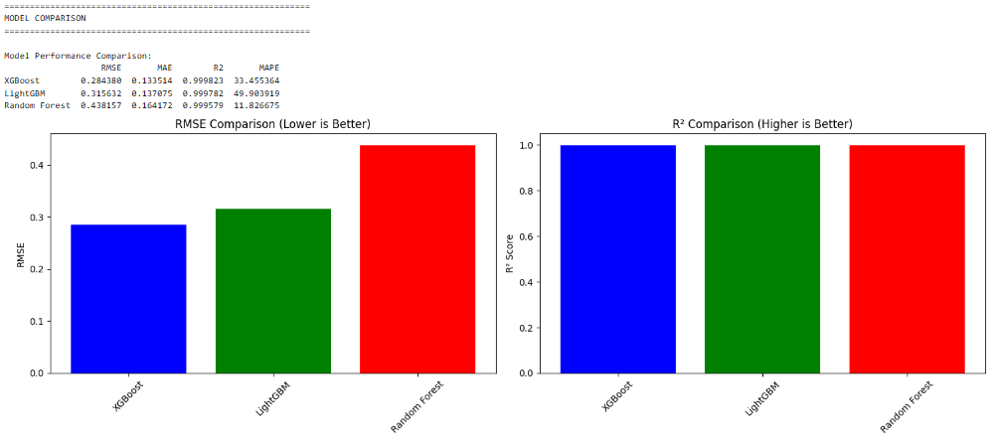
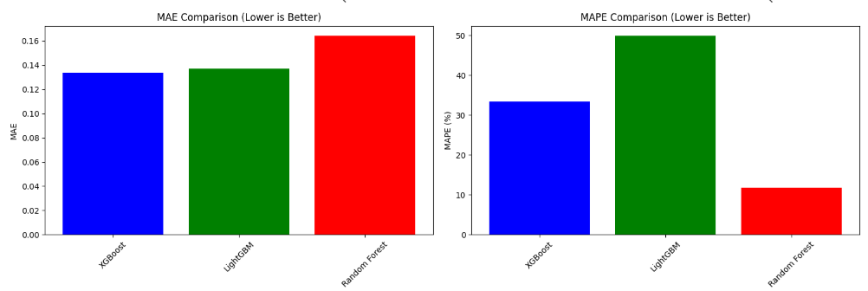
4. Model Performance Comparison

Slide 15
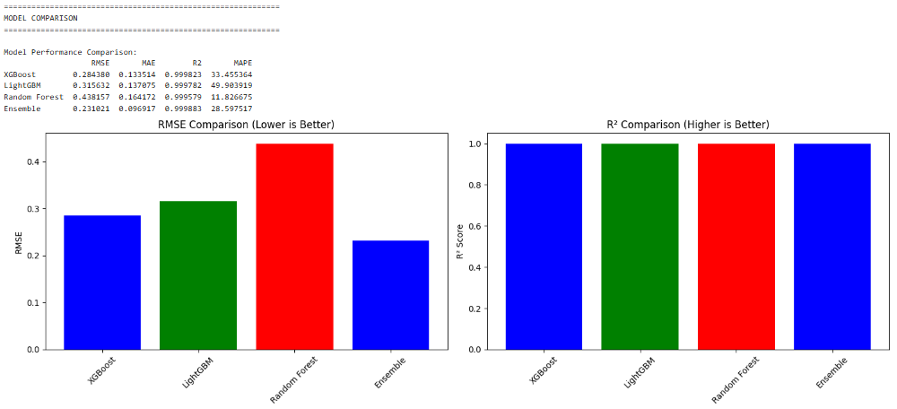
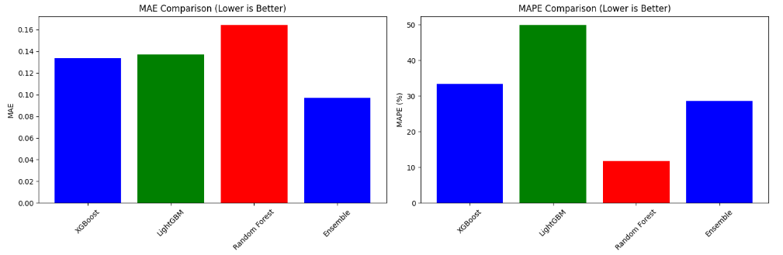
4.1 Model Performance Comparison Ensemble

Slide 16
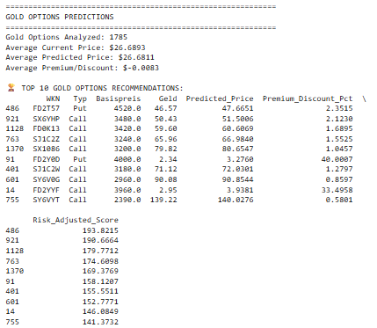
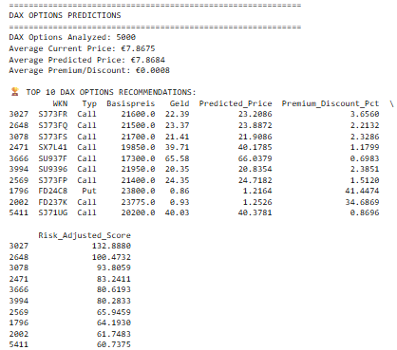
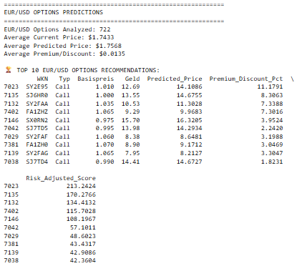
5. Portfolio Construction and Optimzation
GOLD
DAX
EUR/USD

Slide 17
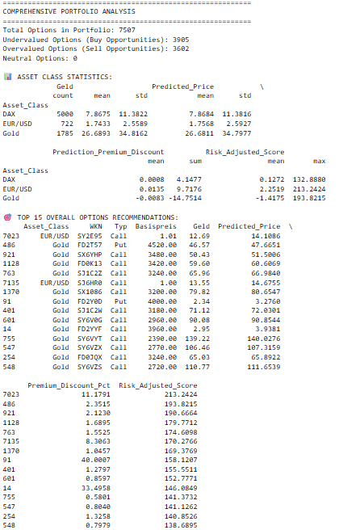
5.1 Portfolio Analysis - - -
Purpose: Transforms individual predictions into comprehensive portfolio insights.
Analytical Features:
Cross-asset comparison of prediction quality
Moneyness vs. expected returns analysis
Time-to-expiry impact on prediction certainty
Asset class performance benchmarking
Visualization: Interactive charts showing price comparisons, distribution analysis, and confidence intervals for easy interpretation.

Slide 18
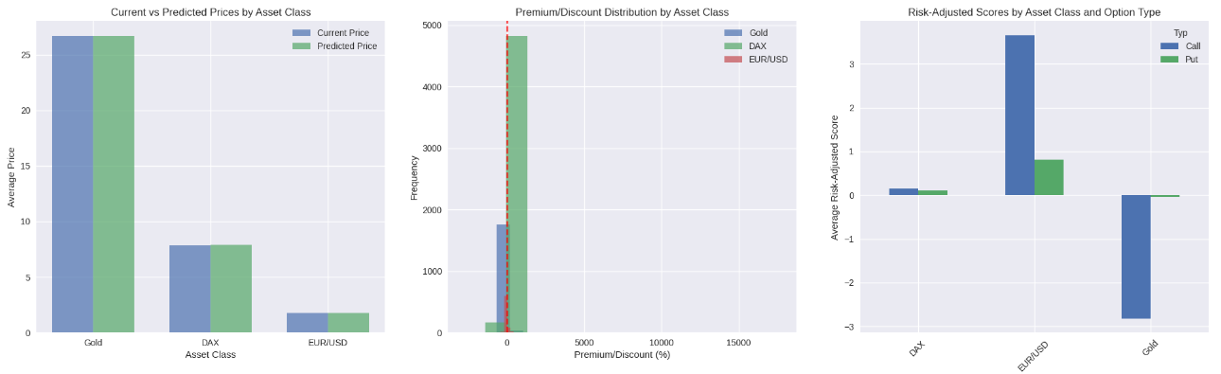
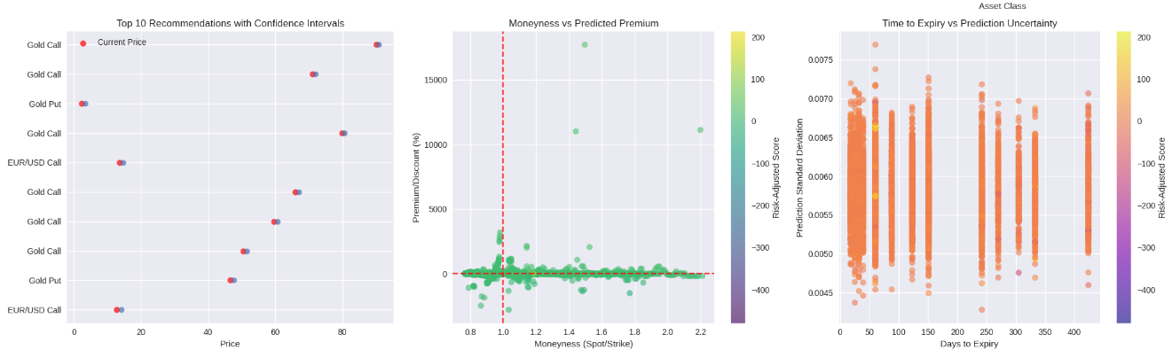
5.1 Portfolio Analysis

Slide 19
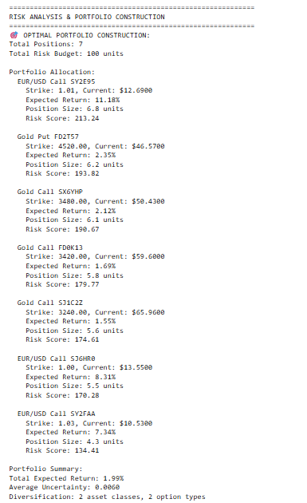
6. Risk Analysis
Purpose: Builds optimal portfolios considering diversification and risk constraints.
Portfolio Construction Rules:
Maximum position size limits (no more than 20% in one option)
Asset class diversification (exposure across Gold, DAX, EUR/USD)
Option type balance (mix of Calls and Puts)
Risk-budget allocation based on confidence scores
Risk Management: Uncertainty quantification, position sizing, and diversification ensure controlled risk exposure.

Slide 20
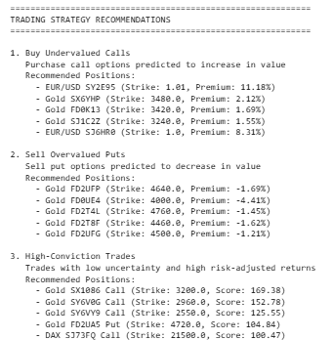
7. Trading Strategy Recommendations
Purpose: Converts predictions into executable trading strategies.
Strategy Types:
Undervalued Calls: Identify call options predicted to increase in value
Overvalued Puts: Spot put options likely to decrease for selling opportunities
High-Conviction Trades: Low-uncertainty, high-return opportunities
Diversified Portfolio Construction: Balanced exposure across assets and option types
Actionable Output: Specific buy/sell recommendations with position sizing and risk management.

Slide 21
8. Key Technological Innovation
Machine Learning Advancements
Ensemble methods combining multiple algorithms for superior accuracy
Advanced feature engineering capturing complex options dynamics
Hyperparameter optimization for model performance maximization
SHAP interpretability for transparent AI decision-making
Financial Engineering
Real-time mispricing identification across multiple asset classes
Risk-adjusted portfolio construction methodology
Confidence-based position sizing algorithms
Cross-asset diversification strategies
Business Impact
For Traders: Identifies profitable opportunities with quantified risk
For Portfolio Managers: Optimizes derivatives exposure across assets
For Risk Managers: Provides uncertainty quantification and diversification metrics
For Researchers: Advanced methodology for options pricing beyond traditional models

Slide 22
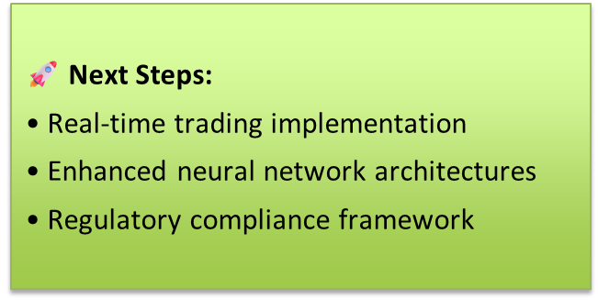
9. Conclusion and Next Steps
This project represents a significant step forward in the application of artificial intelligence to financial derivatives trading.
By successfully bridging the gap between theoretical finance and practical trading, we've created a system that not only predicts options prices with remarkable accuracy but also transforms these predictions into actionable, risk-managed portfolio decisions.
The true innovation lies not just in the sophisticated machine learning models, but in the comprehensive integration of prediction, risk management, and portfolio construction into a unified framework.
As financial markets continue to evolve and AI capabilities advance, this project establishes a foundational framework for the next generation of AI-driven investment systems.
The methodology, insights, and infrastructure developed here pave the way for more sophisticated, adaptive, and intelligent financial decision-making systems in the future.
The era of AI-enhanced derivatives trading has arrived, and this project positions us at its forefront.

Slide 23
Thank You
Questions & Discussion
Contact Information:
Email: sajjadhaider05@outlook.com
GitHub: https://github.com/Sajjad5/Advanced-Time-Series-Predictions-WS26.git

